Slide 1
Preparation for Placement Skills, CVs and Interviews
October 2015

Slide 2
Outline
Careers & Employability Centre
Resources
Skills
CV preparation – how to impress
Interviews
Social Media
What happens next..

Slide 3
Careers & Employability Centre
How we support students and graduates
Offer one-to-one careers advice sessions, at the Careers Centre
15 minute discussion, if you require longer please book a 30 min appointment via MyCareer.
CVs, application checks, mock interviews, job seeking advice, careers guidance, employer events

Slide 4
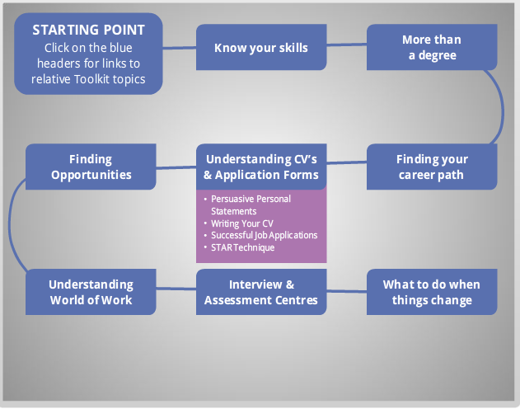
My Career Toolkit
www.rgu.ac.uk/mycareertoolkit
My Career Toolkit is our main online resource, featuring interactive topics . Topics include:
Workplace Professional Behaviours
Writing a Winning CV
Interview Questions
Postgraduate Study and Career Development
Identifying and Selling Skills
Notes:
On the Careers Moodle page you will find our interactive careers topics including Sourcing Graduate Opportunities and Being Social Media Savvy

Slide 5
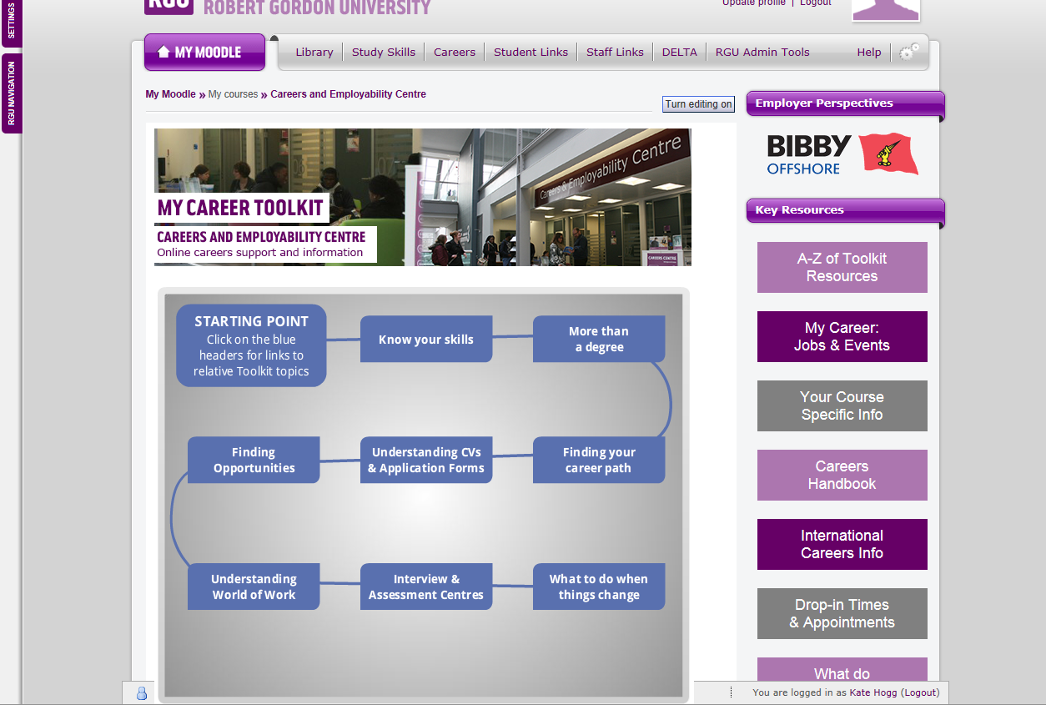
Your course specific resources
Notes:
Other online resources include Course Specific Information and resources for finding work abroad.

Slide 6
CV Preparation
Research what the employer is looking for.
Think about what you have to offer an employer.
Target your CV to the specific job/company.
Give yourself plenty of time to draft ad refine your CV
Notes:
Preparation is the key to a successful CV. You cannot expect to produce a top quality CV in half an hour so give yourself plenty of time!
Think carefully about what you have to offer an employer and research what the employer is looking for. Scrutinise the advertisement/‘job’ description to identify the essential criteria for the position. Do you have the qualities, skills and attributes they seek? You should also make yourself familiar with the company website and any company brochures. It is very important to target your application to the job and the employer. If an employer cannot see that you match their criteria then you are unlikely to be invited for an interview.
If the job requires a specific qualification and you have (or will have) it, make sure it is noted prominently on your CV. Similarly, if you have relevant skills and experience these should be featured preferably on the first page of your CV.

Slide 7
Skills
You need to evidence your ability and potential to the job – this is particularly important if you do not have relevant experience.
Consider what skills the employer might be looking for..
http://www.careerplayer.com/tips-and-advice/engineering/key-skills-for-engineering/

Slide 8
Skills and Attributes
Communication
Teamwork
Leadership
Problem Solving
Flexibility/Adaptability
TARGETjobs
Commitment/Motivation
Relationships
Planning
Analytical Ability
Negotiation
Notes:
Here you can see in more detail some of the key skills employers will be looking for. In each of your examples you will have used a range of skills in order to succeed. Skills including leadership, team work, research, innovative problem solving and communication.
Take a couple of minutes to identify any of the skills you have used.

Slide 9

Identifying your skills
Football team
Tesco!
Group project
Notes:
For the next part I would like you to either get into pairs or threes and take turns to explain/tell each other about your experience.
What have you done that you can use to demonstrate your skill set? Think of a situation you have been in where you worked as part of a team or had to organise and plan your time when working to a deadline, or came up with an innovative idea to solve a problem?
Jot down or discuss down an example with your neighbour. I will come back to skills later..

Slide 10
Identify your skills
Pick a skill sought by employers
In pairs discuss how you might have gained this skill..
Write down
- the skill you possess
- an example of how you gained it
- note some details i.e. specific info that demonstrates you have the skill

Slide 11
CV advice - Video
http://www.careerplayer.com/tips-and-advice/general-advice/polish-up-your-cv
Notes:
We are just going to watch a short video on what employers want to see in a CV.
Ask audience their thoughts about these comments.
Talk around main points from video.

Slide 12
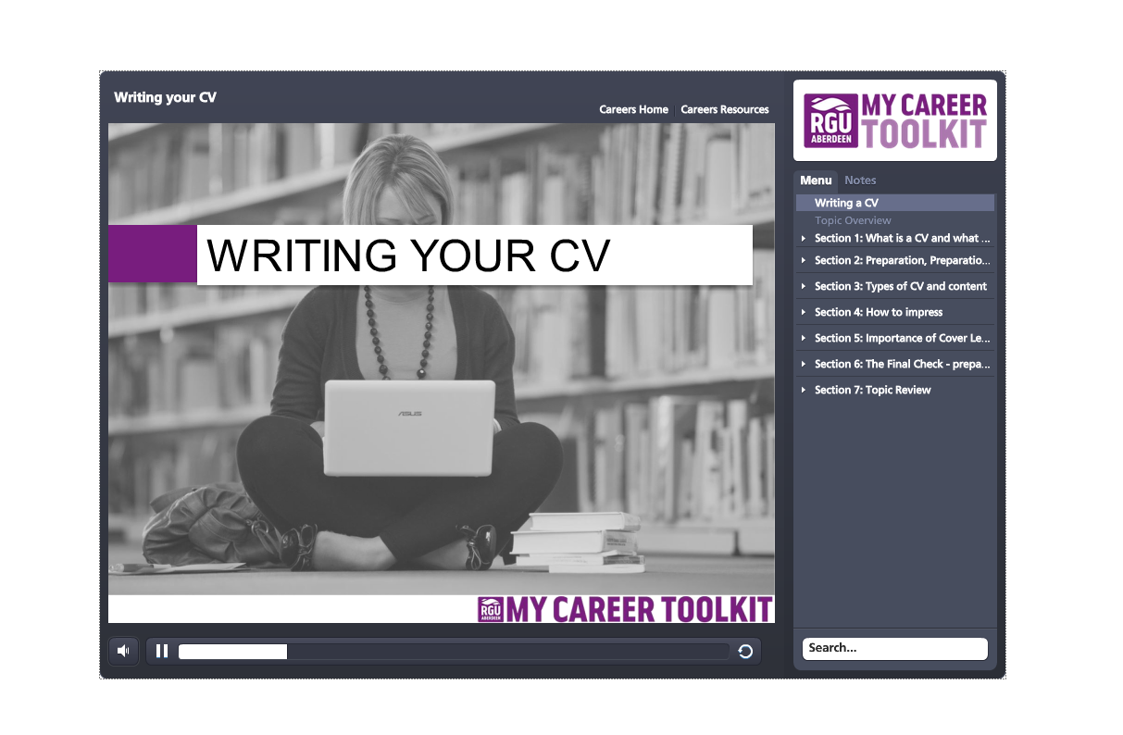
CV topic
www.rgu.ac.uk/mycareertoolkit

Slide 13
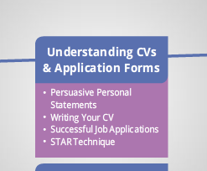
Effective Applications
CVs
Application Forms
Personal / Supporting Statements
Cover Letters
Notes:
So effective applications. Your main method of application will be your CV and cover letter/email. More information on preparing these documents can be found in the understanding CVs and application form topics on Moodle.

Slide 14
What type of CV?
Chronological
Provides all the information most employers want in a familiar format and demonstrates steady development in education and career.
Lists education and work experience by date with most recent information first.
Notes:
There are two main types of CV produced. One is chronological, this is the more traditional CV. It lists all your experience and qualifications in reverse chronological order, divided into sections. It shows have you have developed over time. This might work well for you if you have relatively little work experience or your experience has been in the same employment sector throughout

Slide 15
What type of CV?
Skills-based
Same headings, different lay-out with targeted approach through skills matching.
Work experience details kept to a minimum
Useful for highlighting particular skills enabling the selector to understand the relevance of skills and experience and for distracting away from a varied career history
Notes:
A skills based CV contains the same information but is organised differently. In this version you need to focus on the skills the employer is seeking and give evidence to demonstrate how you have developed these skills. You will give briefer details about your education and work experience as much of the relevant information will appear under your skills headings

Slide 16
CV tips
Tailor your CV to each organisation.. show how well suited you are
Two pages max
Consider the lay out, font, size of font
An employer may only spend 15-30 seconds looking at your CV!
Pay attention to the detail – you may be deselected for spelling or grammatical errors
Stand out from the crowd – highlight your achievements

Slide 17
How to impress - Objective
Explain who you are
What you can offer
What you are looking for
‘Third year MEng Mechanical Engineering student with excellent problem solving, interpersonal, and organisational skills developed through degree studies and various employment positions. Seeking a placement position in the energy industry’

Slide 18
It’s how you say it..
Team Work
Active member of University Rowing team
Or
Active member of University Rowing team, attended weekly training sessions and helped organise fundraising event which raised over £1000 for boathouse repairs
Negotiation
Class Representative for two years running
Or
As Class Representative for two years running discussed students viewpoints on timetabling issues with the university management team, reaching a successful resolution
Notes:
In the skills section it is important how you say the information not just what you say.The wording of these examples gives an employer a much better understanding of exactly what was involved and really demonstrates your skills.

Slide 19
Selling yourself effectively
Telling Statement:
Worked as a Assistant Engineer during work placement with an oil service company.
Worked on developing cost estimating model
Selling Statement:
Selected from over 80 applicants for a 12 month work placement as an Assistant Engineer within the Aberdeen branch of a global award winning oil service company.
After two months working within company’s well management team was allocated responsibility for developing cost estimating model for future wells, reviewing 17 ½” section of a difficult well and liaising with a rig team
Offered a graduate position with the company after graduation as a result of performance on placement
Notes:
This is an example of how to utilise this technique in a project section or work experience.

Slide 20
How to impress - achievements
Awarded ‘Employee of the Month’ prize in August 2014, for exceeding sales targets
Successfully trained for and completed two 10KM sponsored races raising over £500 for a local charity
Student representative on the RGU Staff/Student Committee 2014/2015 which involved canvassing student opinion, complaints and ideas, and communicating to academic staff
Extensive travel of USA and Canada during summer of 2015, travelled independently developing confidence and the ability to be flexible as travel plans changed

Slide 21
Use STAR!
A Simple but effective tool you can use
throughout all applications processes
S - Situation 10%
T - Task 10%
A - Action 70%
R - Result 10%
Notes:
The STAR approach is recommended by employers as a technique for answering questions to ensure you present your experience successfully. This could be in application forms and interviews.

Slide 22
STAR example
Please describe a project/event you have had to organise and the obstacles you had to overcome
S= Whilst I was working as a Team Leader for Super Supermarket, I was responsible for organising and allocating the work of six shelf fillers on each of my shifts
T= I had to ensure that each shelf filler was aware of their duties and responsibilities, had enough shelves allocated to them and completed their tasks by a certain time on each shift.
A= I drew up a plan for each shift taking into account the number of staff available , the number of shelves to be filled and estimated how long it would take each team member to complete the task, taking lunch breaks into account
R= The work was completed on time, my Manager was satisfied and happy with the plan I provided and complimented me on my excellent organisational and time management skills.

Slide 23
STAR Example 2
Describe a time when you played an important role in a project as a member of a team:
Participated as a member of the engineering team in the Shell Uni project and built a car able to complete a set number of laps of a race track using as little fuel as possible. Assisted in the design and fabrication of the car. Created CAD drawings, selected and cut suitable materials to the dimensions on the drawings and visited a local engineering fabricator to have the chassis welded. The project won the best in class.
Notes:
Take a couple of minutes to look at your example from earlier.
How would you use the STAR approach to describe your example?
The My Career Toolkit topic, ‘STAR Technique’ will give you further examples.

Slide 24
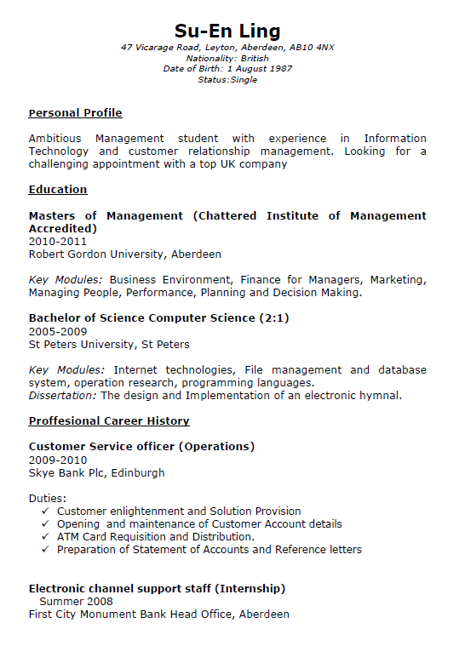
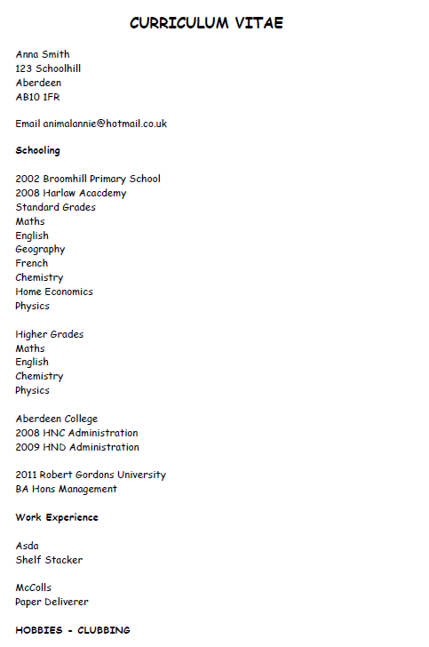
The Good, the Bad & the Ugly!

Slide 25
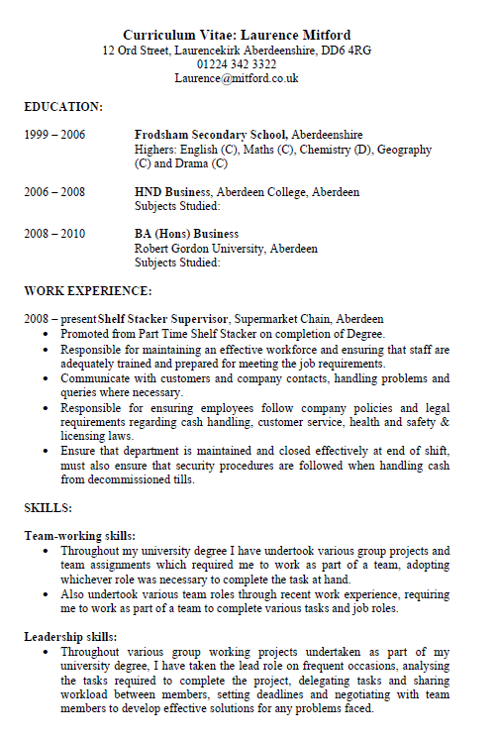
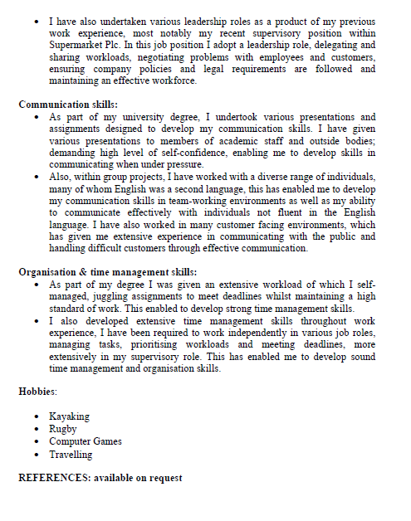
The Good, the Bad & the Ugly!

Slide 26
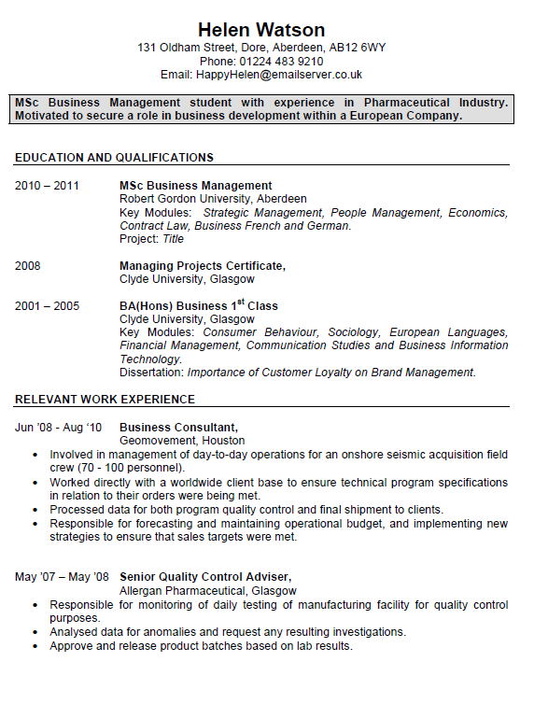
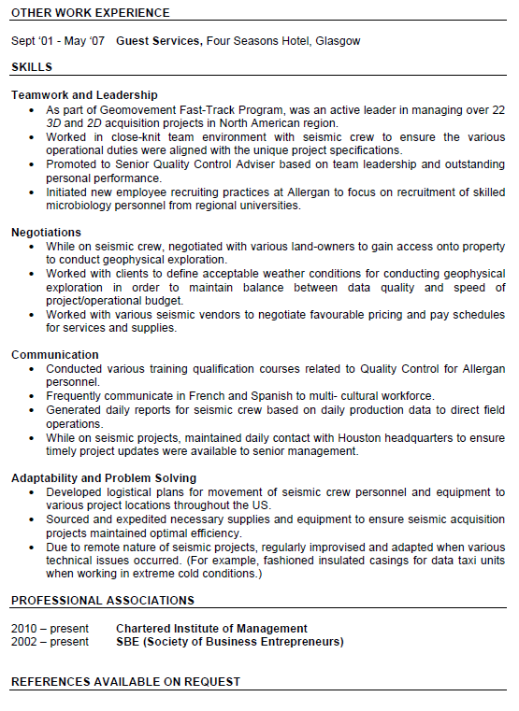
The Good, the Bad & the Ugly!

Slide 27
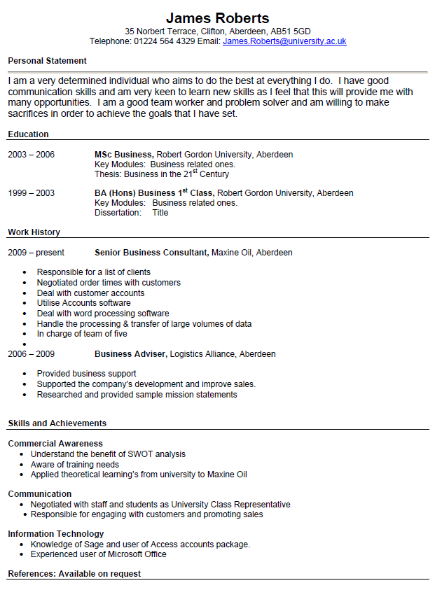
The Good, the Bad & the Ugly!
Which is which??
Does your CV look like any of these?!

Slide 28
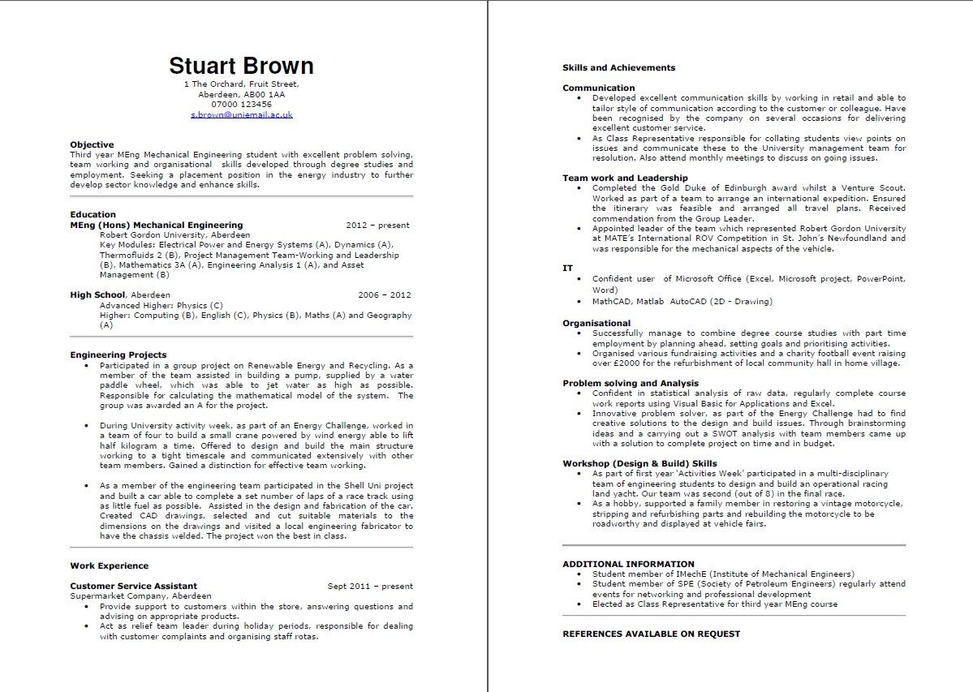

Slide 29
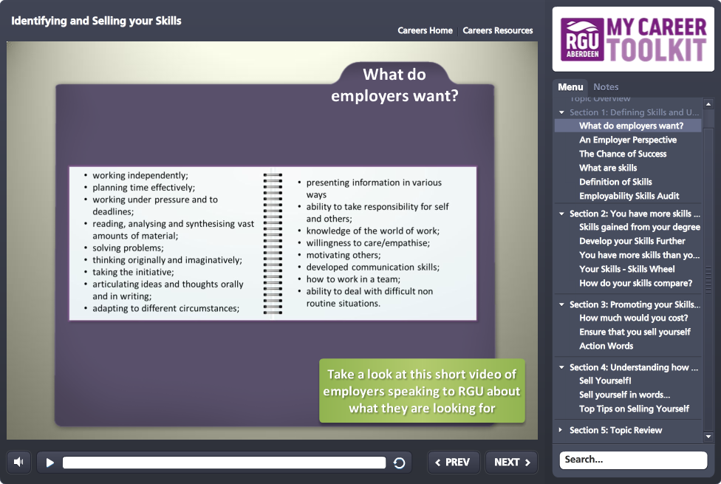
My Career Toolkit Topic
Employer Perspectives Videos
Notes:
For more detail on the skills employers are looking for and how to evidence these, you should take the time to work through the ‘Identifying and Selling your Skills’ toolkit topic which you can find under the ‘Know Your Skills’ heading.
Remember it’s not always what you say but how you say it, these toolkit topics will help you to showcase your skills to employers.

Slide 30
Cover Letter..why you need one
The covering letter gives you the opportunity to get recruiters interested in you and your CV, it allows you to
Demonstrate to the employer your interest in the job and your knowledge of the company
highlight your unique selling points
provide additional information
explain any personal circumstances
Notes:
A cover letter gives you another opportunity to demonstrate your suitability as a candidate. It is required in most situations when you are applying for a job with a CV, and you should always send one when you are contacting an employer speculatively.

Slide 31
Cover letter - layout
Word-processed, unless requested otherwise
Consistent font with your CV
One page of A4
Three or four paragraphs
Keep to the point
Use clear language
Notes:
Unless you are specifically asked to apply in your own handwriting you should word process your letter in the same font as your CV.
One page should be sufficient. Divide your letter into paragraphs. The first paragraph should introduce you..who are you? What/where are you studying? Tell the employer why you are writing to them, what job are you applying for, where have you seen it advertised? If you are applying speculatively state what kind of position you seek.
The second paragraph should include information about why you are a suitable candidate for this job. Refer to your CV and highlight how your skills/knowledge/experience match their requirements and how they would benefit from employing you.
Paragraph three is where you can demonstrate your knowledge of the organisation you are applying to. Why are you interested in them and the position? Show that you know what they do/their services/clients etc
Your final paragraph should have a positive ending, you are looking forward to discussing your application further at interviews and say when you are available for interview (or dates when you are not)
Keep the language plain and to the point, avoid over long sentences.
End with ‘Yours sincerely’ if you know the name of the person you are writing to or ‘Yours faithfully’ if you have addressed the letter ‘Dear Sir/Madam’

Slide 32
Content
1st - Introduce yourself, state what are you studying and why you are writing to them.
2nd - Include information about why you are a suitable candidate for this job.
3rd - Here you can demonstrate your knowledge of the organisation
4th – Positive ending
Notes:
One page should be sufficient. Divide your letter into paragraphs. The first paragraph should introduce you..who are you? What/where are you studying? Tell the employer why you are writing to them, what job are you applying for, where have you seen it advertised? If you are applying speculatively state what kind of position you seek.
The second paragraph should include information about why you are a suitable candidate for this job. Refer to your CV and highlight how your skills/knowledge/experience match their requirements
Paragraph three is where you can demonstrate your knowledge of the organisation you are applying to. Why are you interested in them and the position? Show that you know what they do/their services/clients etc
Your final paragraph should have a positive ending, you are looking forward to discussing your application further at interviews and say when you are available for interview (or dates when you are not)
Keep the language plain and to the point, avoid over long sentences.
End with ‘Yours sincerely’ if you know the name of the person you are writing to or ‘Yours faithfully’ if you have addressed the letter ‘Dear Sir/Madam’

Slide 33
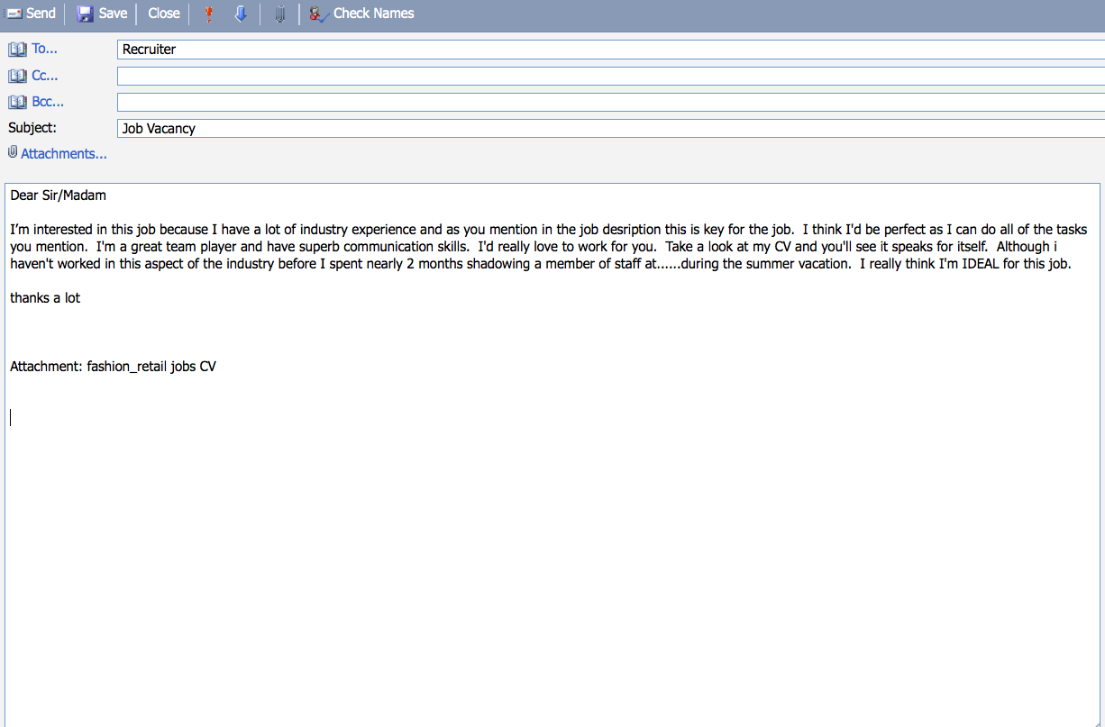
Applying via email
Poor Application
The name of the attachment shows this is just one of many roles applied for
The lack of named contact shows the applicant hasn’t done their research
The writer is enthusiastic and says something about their experience but has made a bad assumption that the employer can get most of the information they need from the CV
The overall tone is unprofessional and a little arrogant, using superlatives such as perfect, superb etc. despite offering little to substantiate claims made
The text is poorly planned with no structure and contains spelling and grammatical errors. It ends very abruptly.
Notes:
You might be surprised that many individuals do not know how to appropriately present themselves in communication with potential employers.

Slide 34
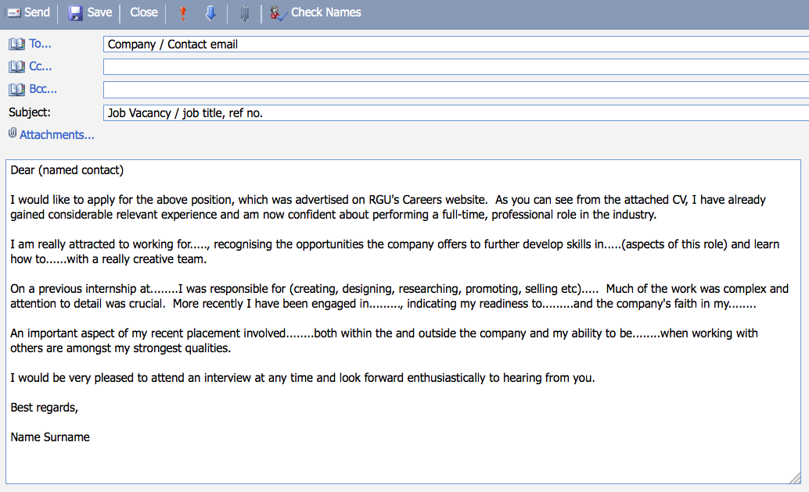
Better application
The applicant references their CV and quickly establishes their experience and interest in the role
The second paragraph informs the reader WHY the applicant wants to work for this organisation
The next two paragraphs relate to the job and give clear examples and evidence of their relevant experience
Strengths are indicated abut not overstated
The message ends politely
Notes:
This a better example of an application email.

Slide 35
The final check
Spelling and Grammar
Are all your answers/examples relevant?
Is all your time accounted for?
Have you followed all instructions?
Get your CV and cover letter checked before sending it out
Keep a copy for future reference
Notes:
And finally, before you send your application out do check it over, better still get someone else to look at it for you. Take it into the Careers Centre to get some feedback on its suitability. You can make an appointment by going to our Homepage www.rgu.ac.uk/careers, click on 'Careers Link' then login using your network (Novell) account, then click on Current Student then Book an Appointment with a Careers Consultant and follow the steps to make a booking. Alternatively, you can attend a drop-in session. There is a session available most days from 10 - 4. You do not need to book for this as it is on a first come first served basis and the exact times are available on the Careers website.

Slide 36
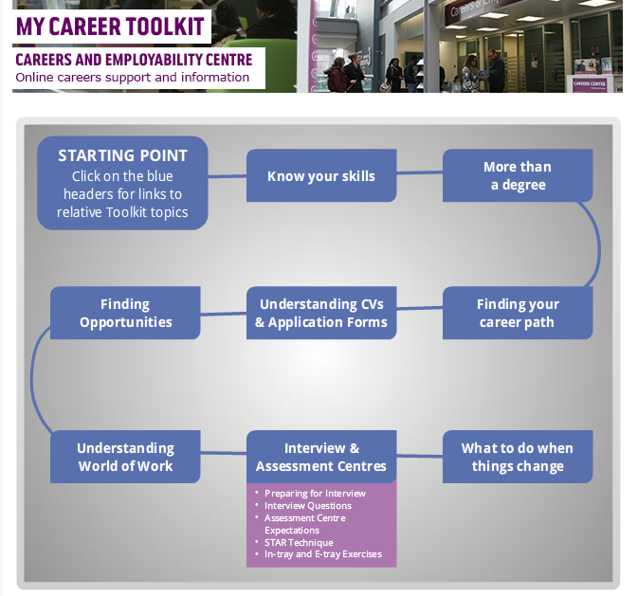
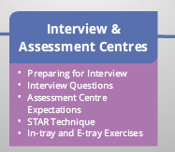
Interviews and Assessment Centres
Notes:
The My Career Toolkit will take you through the interview process from preparing for an interview, example interview questions, what to expect at an assessment centre and links to practice psychometric tests.
Competency based questioning is often used and some employers are using a strength based interview technique to find out what type of person you are. Here you are expected to answer quickly without thinking, they are looking for your reaction to rapid fire questions for example would you say you are a team player or more of a leader.
(Example of good and bad interviews or video)
https://www.youtube.com/watch?v=JVA8Vqkwwcw
Role play?

Slide 37
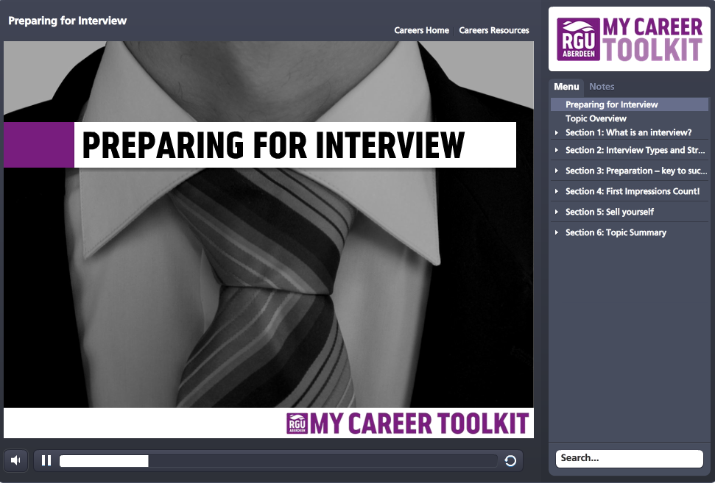
Interviews
www.rgu.ac.uk/mycareertoolkit

Slide 38
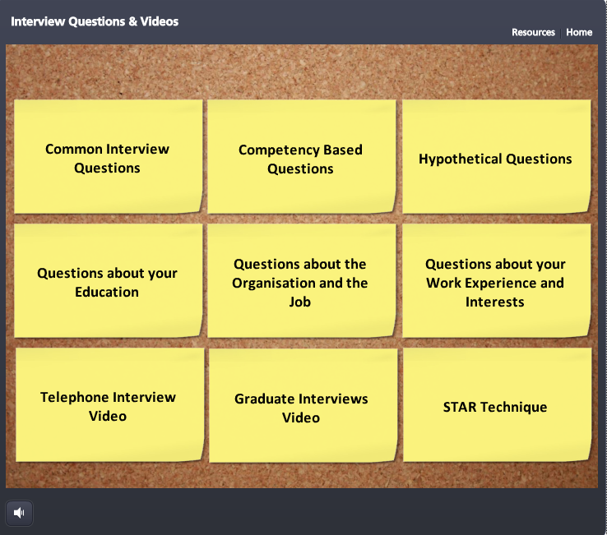
Interview Questions
Example interview questions can be found in the toolkit topic ‘Interview Questions’
Notes:
This topic looks at interview questions and how to answer them. There are also some further examples on STAR approach.

Slide 39

Where to start your placement search
InPlace
MyCareer: Jobs and Events
Graduate Recruitment Websites
The Hidden Job Market – Speculative Applications
Social Media and Networking
Careers Fairs
Newspapers
Notes:
Frances has given you lots of information but here are some examples of where to find placements. When it comes to graduate job search recruitment agencies are also a useful resource. The My Career Toolkit section on ‘Finding Opportunities’ is a great place to start. The topics include, ‘Sourcing Graduate Opportunities’ and ‘Networking for Success’. Working through these topics will give you information and more detail on where to start your graduate job search.

Slide 40
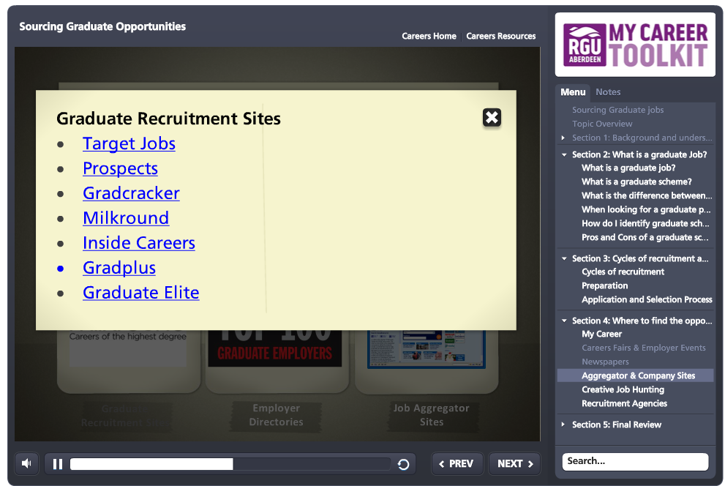
My Career Toolkit Topic
Notes:
For example, the ‘Sourcing Graduate Opportunities’ topic contains live links to Aggregate and Company recruitment websites which advertise current graduate jobs.

Slide 41
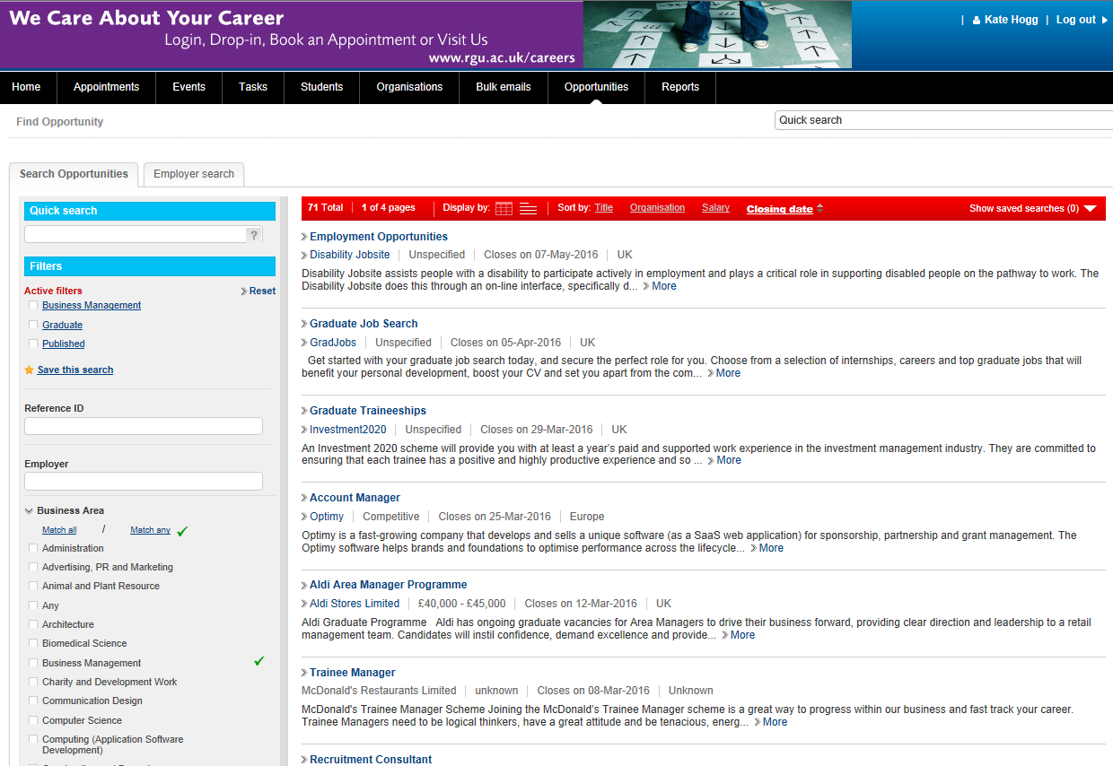
Notes:
Employers contact RGU directly with vacancies. These are found on our searchable vacancy database accessed through MyCareer: Jobs and Events. You will need to sign in using your university username and password and you have the option to set up search criteria for individual job emails.

Slide 42

Social Media Networks
Use Twitter / Linkedin / Facebook / blogs to gather knowledge, information, advice, look for work and make contacts
Recent research shows 98% of hiring managers view candidate profiles on Linkedin prior to interview
92% of companies use social media for recruiting
Delete old or unused social media accounts.
Keep your identity consistent, showcasing your experience professionally and thoughtfully.
Notes:
Social media is also a useful tool.

Slide 43
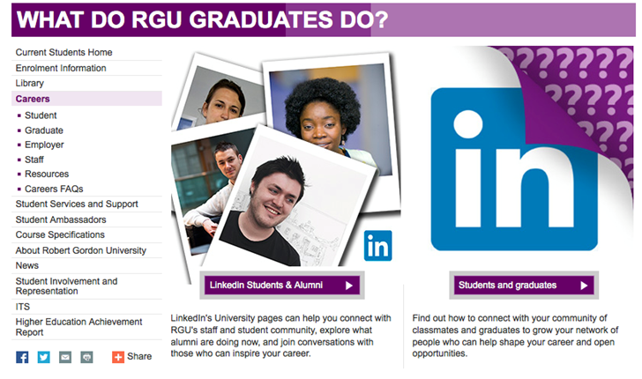
RGU Social Networks
https://students.linkedin.com/uk
N.B. Be professional at all times

Slide 44
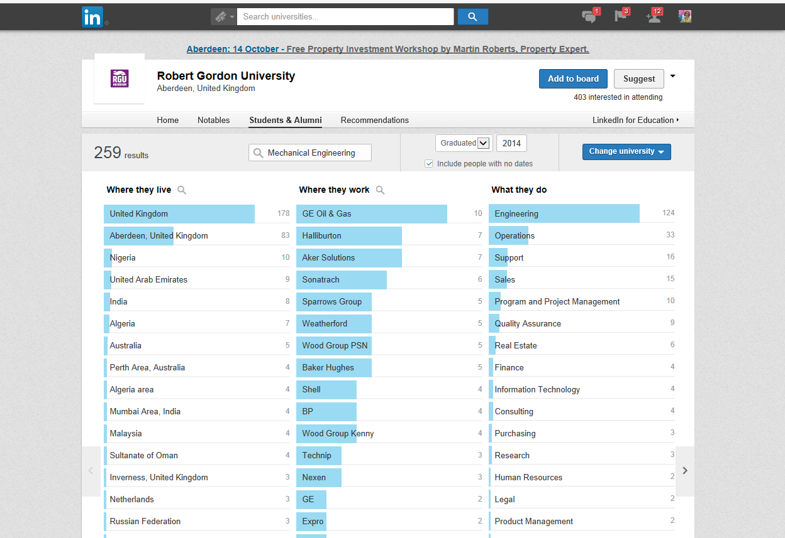

Slide 45
Take a moment
Do you know what your options are?
Are you happy with your CV?
Are you prepared for interviews?
Do you have a plan?
Notes:
Bearing in mind what you have seen and heard today, how would you answer these questions now?

Slide 46
What now?
You will receive an email with a link to a Moodle page
Moodle page will have :
- this presentation
- CV templates
- further online resources
We will arrange a date for follow up CV feedback

Slide 47


Keep in touch
careers@rgu.ac.uk
@rgucareers
www.facebook.com/rgucareers
www.rgu.ac.uk/mycareertoolkit

Slide 48
Any questions?
?

